Slide 1
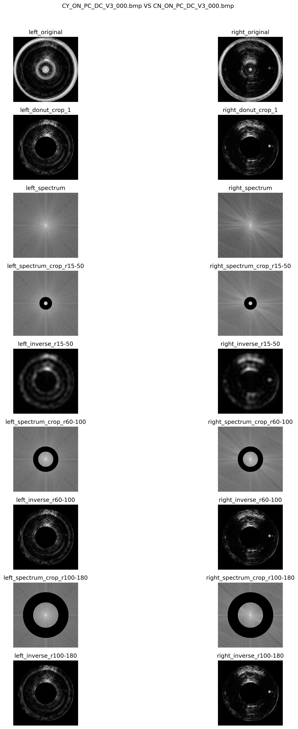
P0_spectrum_comparisons_crop / CY_ON_PC_DC_V3_000_VS_CN_ON_PC_DC_V3_000.png

Slide 2
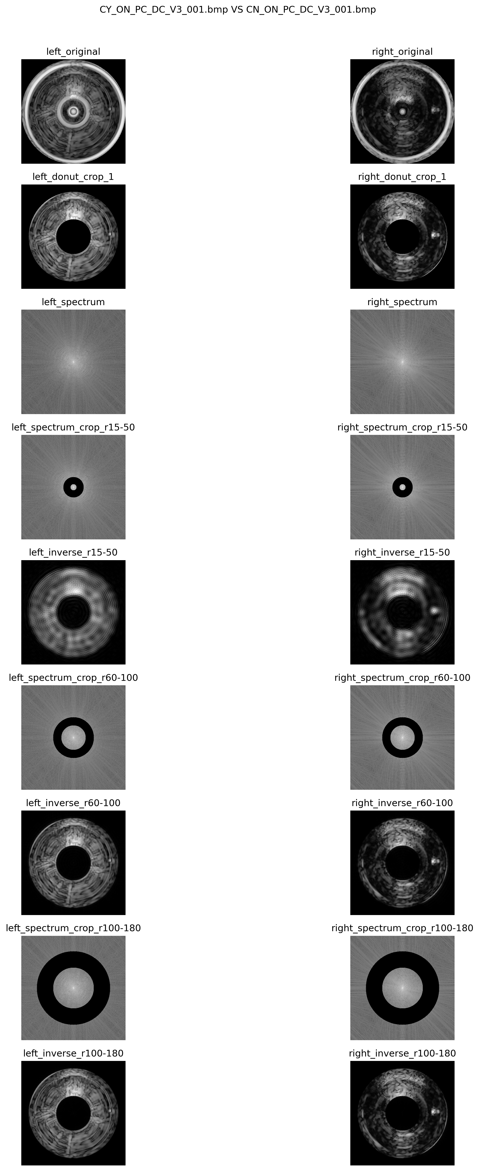
P0_spectrum_comparisons_crop / CY_ON_PC_DC_V3_001_VS_CN_ON_PC_DC_V3_001.png

Slide 3
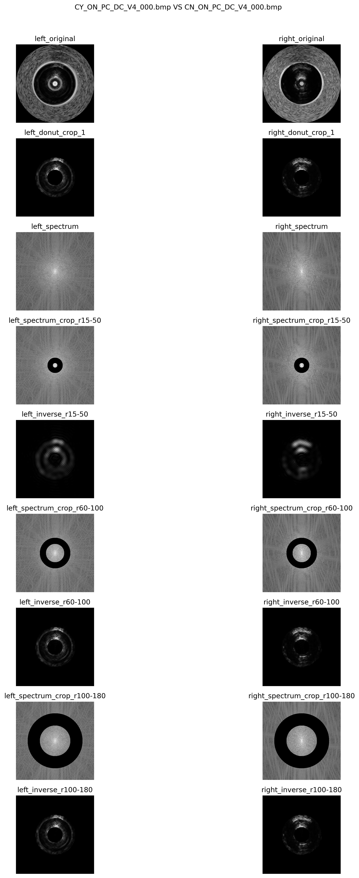
P0_spectrum_comparisons_crop / CY_ON_PC_DC_V4_000_VS_CN_ON_PC_DC_V4_000.png

Slide 4
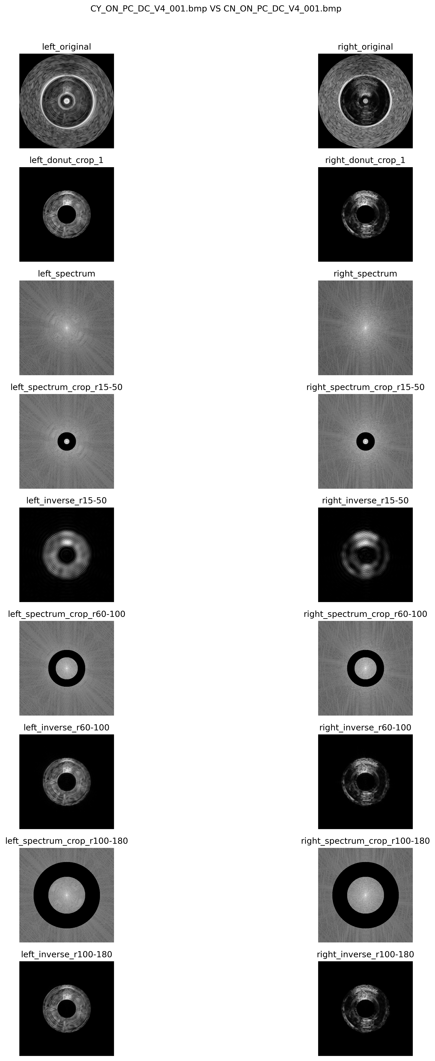
P0_spectrum_comparisons_crop / CY_ON_PC_DC_V4_001_VS_CN_ON_PC_DC_V4_001.png

Slide 5
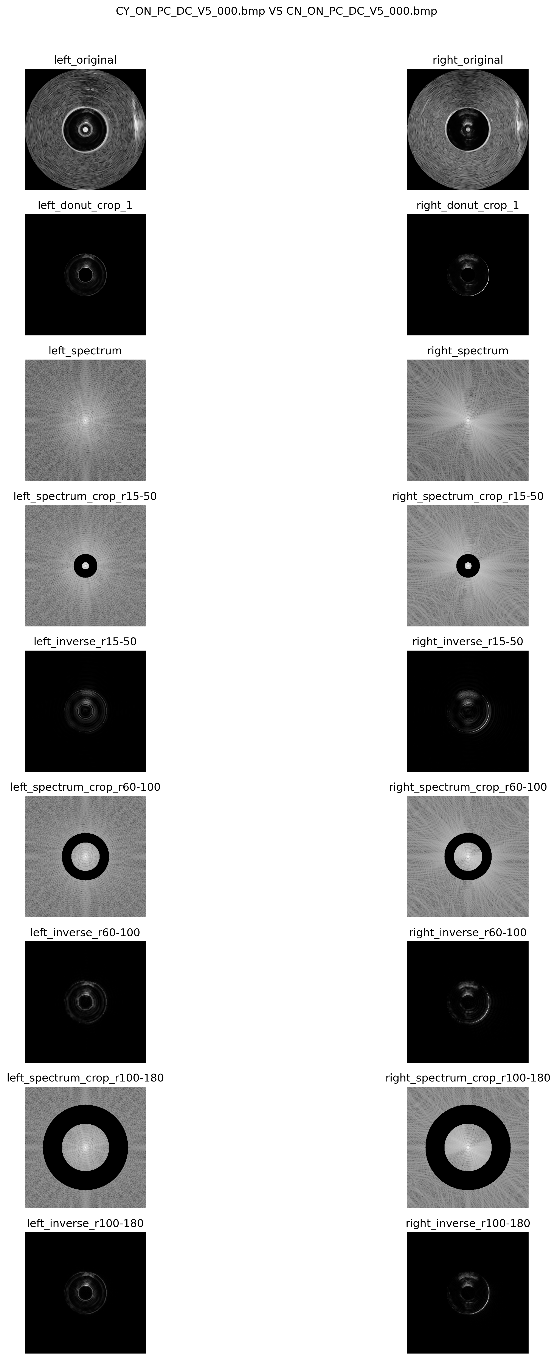
P0_spectrum_comparisons_crop / CY_ON_PC_DC_V5_000_VS_CN_ON_PC_DC_V5_000.png

Slide 6
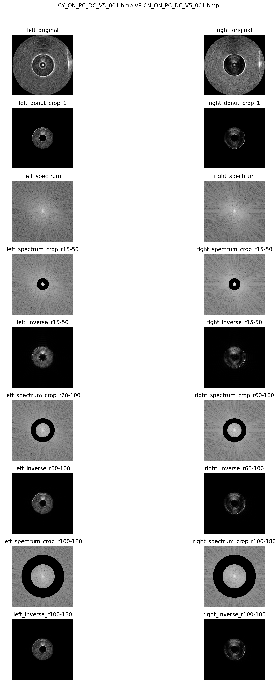
P0_spectrum_comparisons_crop / CY_ON_PC_DC_V5_001_VS_CN_ON_PC_DC_V5_001.png

Slide 7
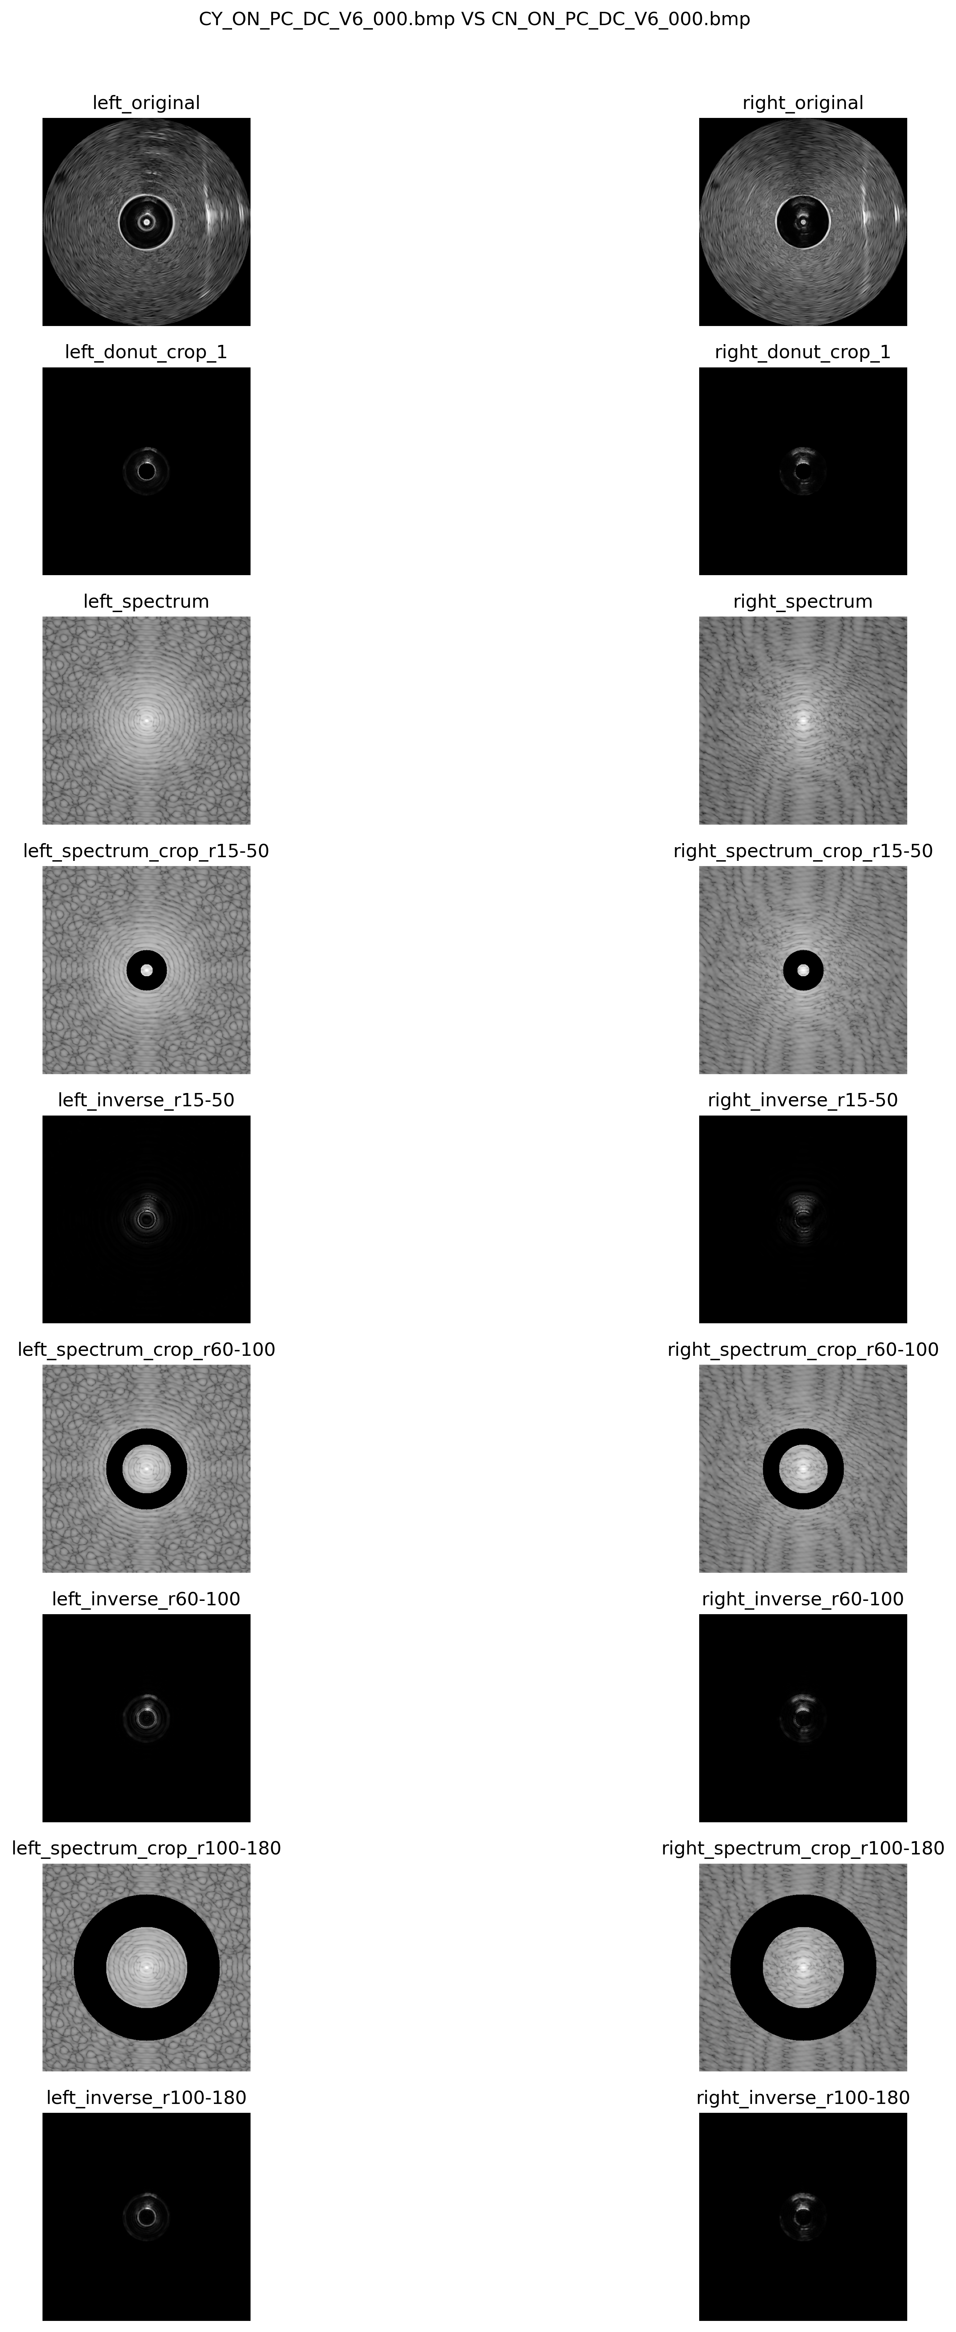
P0_spectrum_comparisons_crop / CY_ON_PC_DC_V6_000_VS_CN_ON_PC_DC_V6_000.png

Slide 8
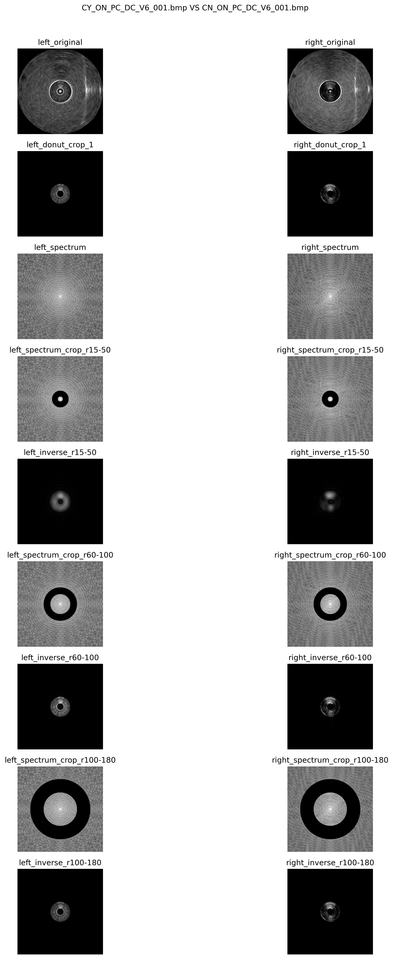
P0_spectrum_comparisons_crop / CY_ON_PC_DC_V6_001_VS_CN_ON_PC_DC_V6_001.png

Slide 9

P0_spectrum_comparisons_crop / CY_ON_PC_DC_V7_000_VS_CN_ON_PC_DC_V7_000.png

Slide 10

P0_spectrum_comparisons_crop / CY_ON_PC_DC_V7_001_VS_CN_ON_PC_DC_V7_001.png

Slide 11
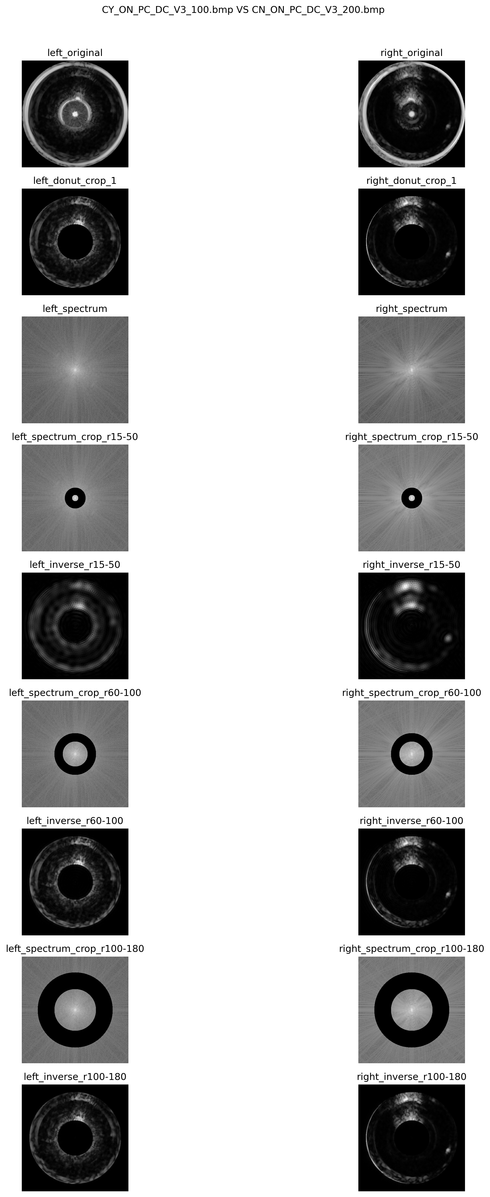
P2_spectrum_comparisons_crop / CY_ON_PC_DC_V3_100_VS_CN_ON_PC_DC_V3_200.png

Slide 12
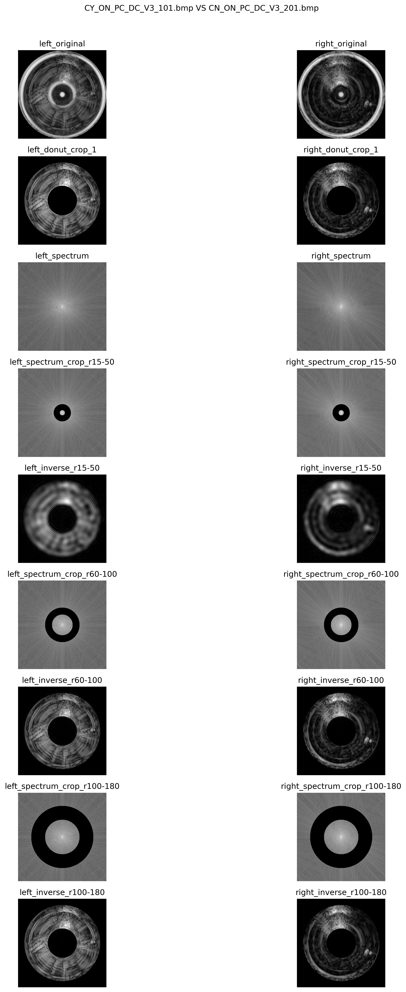
P2_spectrum_comparisons_crop / CY_ON_PC_DC_V3_101_VS_CN_ON_PC_DC_V3_201.png

Slide 13
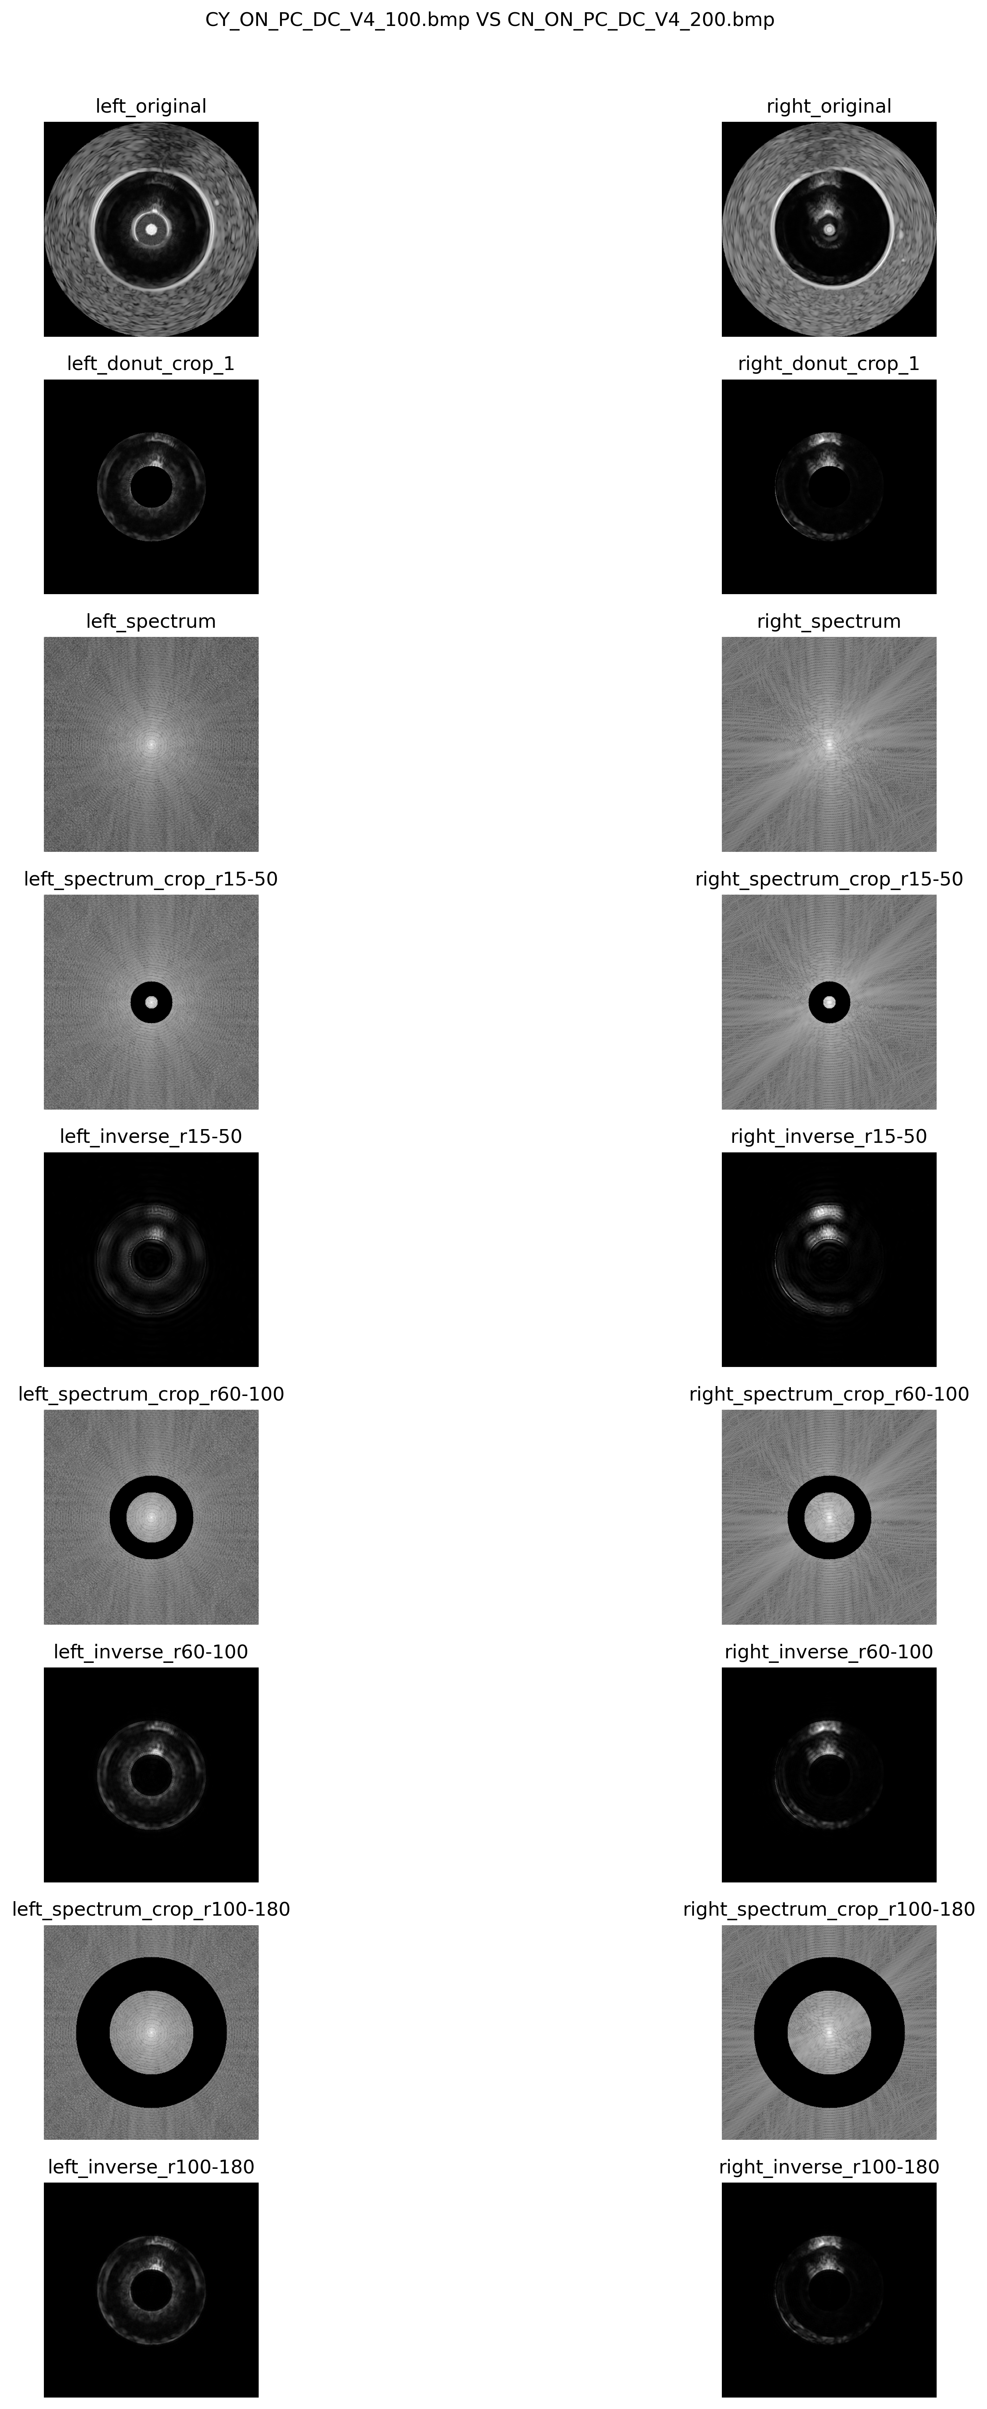
P2_spectrum_comparisons_crop / CY_ON_PC_DC_V4_100_VS_CN_ON_PC_DC_V4_200.png

Slide 14
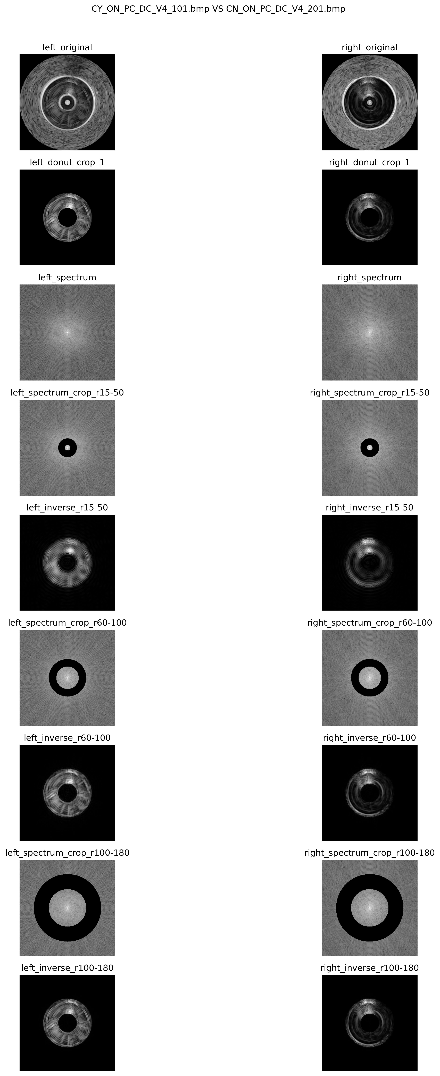
P2_spectrum_comparisons_crop / CY_ON_PC_DC_V4_101_VS_CN_ON_PC_DC_V4_201.png

Slide 15
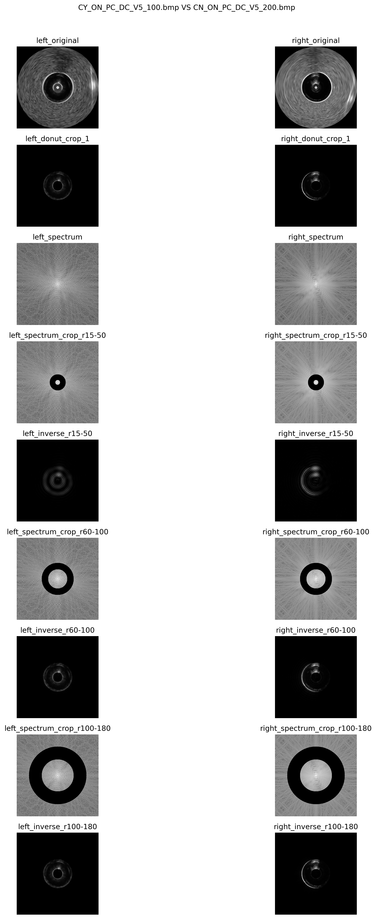
P2_spectrum_comparisons_crop / CY_ON_PC_DC_V5_100_VS_CN_ON_PC_DC_V5_200.png

Slide 16

P2_spectrum_comparisons_crop / CY_ON_PC_DC_V5_101_VS_CN_ON_PC_DC_V5_201.png

Slide 17
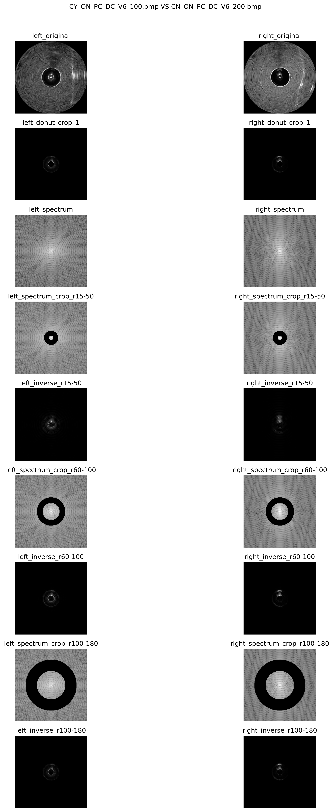
P2_spectrum_comparisons_crop / CY_ON_PC_DC_V6_100_VS_CN_ON_PC_DC_V6_200.png

Slide 18

P2_spectrum_comparisons_crop / CY_ON_PC_DC_V6_101_VS_CN_ON_PC_DC_V6_201.png

Slide 19

P2_spectrum_comparisons_crop / CY_ON_PC_DC_V7_100_VS_CN_ON_PC_DC_V7_200.png

Slide 20
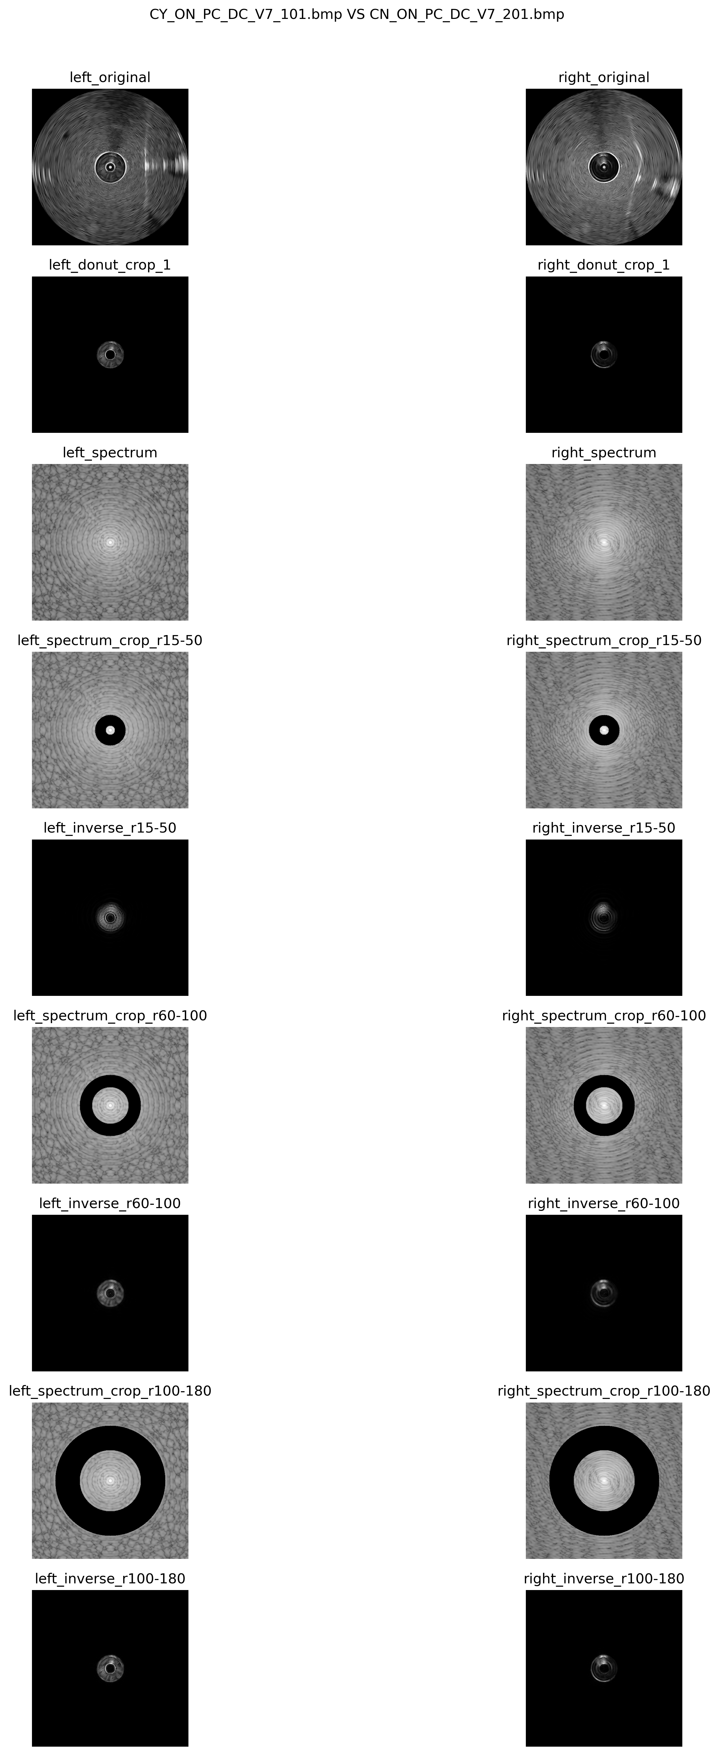
P2_spectrum_comparisons_crop / CY_ON_PC_DC_V7_101_VS_CN_ON_PC_DC_V7_201.png

